Slide 1
Optimizing K In Latent Dirichlet Allocation (LDA) Topic Modeling
Trish Goedecke, Jerry Duncan, Preston Provins
COSC 545 Dr. Audris Mockus
Fall 2018

Slide 2
Optimizing K in LDA Topic Modeling
Assumptions of Latent Dirichlet Allocation
K optimization models
Example of application with UT Austin classroom chat data

Slide 3
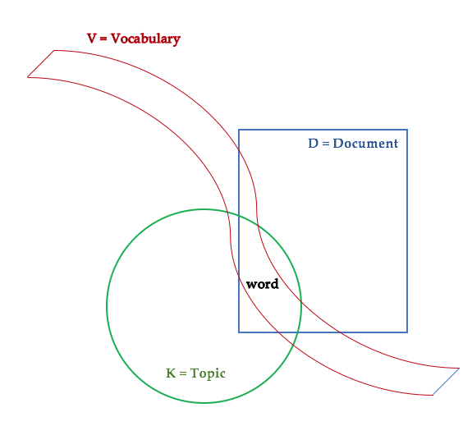
The Basic Relationships: V,K,D,N_{d}
N_{d} = Number of words in Document d

Slide 4
Simplification of document construction underlying LDA
K topics
D documents
Within each document, N_{d} words
Each document has a unique distribution of the topics
𝛳_{d} is a vector of K topic probabilities for the given document
Theoretically, within a given document d, each word is drawn from one of the K topics with the given 𝛳_{d} probabilities
Notes:
… if it weren’t Bayesian…

Slide 5
Key LDA Assumption: Exchangeability
For LDA:
Assume that words are generated by topics
Assume topics are infinitely exchangeable within a document
Exchangeability: A set of random variables is exchangeable if the joint distribution does not change with permutation; ie, any order is equally likely.
De Finetti’s theorem: The joint distribution of a set of infinitely exchangeable random variables behaves as if the random variables were independent and identically distributed (iid), conditioned on a parameter drawn from some distribution.

Slide 6
Theoretical document construction underlying LDA, Blei et al
Select N from Poisson(ξ)
Select 𝛳 from Dirichlet(α)
For each of N words w_{n}:
Choose topic z_{n} from Multinomial(𝛳)
Choose word w_{n} from p(w_{n}|z_{n}, β), a multinomial probability conditioned on the topic z_{n}

Slide 7
Variable Descriptions
Symbol | Name | Type | Description
Nd |  | Discrete | Number of words in a document
D |  | Discrete | Number of documents in corpus
V |  | Discrete | Number of distinct words in the total vocabulary
W_{dnj} |  | Binary | 1 if nth word in document d is jth word in vocabulary; otherwise 0
Z_{ni} to Z_{nk} |  | Binary | 1 if nth word is from Topic i; 0 otherwise
α | alpha |  | Model-specific hyperparameter
β_{k} | beta |  | Topic-specific hyperparameter of Dirichlet distribution 1 through K
𝜏 | tau |  | Fully conditional posteriors for Gibbs sampling
φ_{zn} | phi |  | Drawn from Dirichlet (β,Zn)

Slide 8
Topic model comparisons: prior analyses

Slide 11
Notes:
Note: Looking at the quadratic curves, we see the Change in Perplexity (dP) has a maximum near where the Perplexity has a minimum.
If we were to take a difference (subtraction) between the two curves, it appears there is a local maximum near K=15, local minimums near K=10 and K=20.

Slide 12
Notes:
When we subtract the Perplexity from Change in Perplexity, we do not see the form anticipated by the quadratic curves.

Slide 13
Additional comparison methods for optimizing K:
Human judgment (Chang et al, 2009)
Latent Semantic Analysis (Niraula et al, 2013)
Goodness of Fit (Bowman, Chen and George, 2016)

Slide 14
Selection of Works Cited
Blei, D. M., Ng, A. Y., & Jordan, M. I. (2003). Latent dirichlet allocation. the Journal of machine Learning research, 3, 993-1022.
Bowman D., Chen, J., & George E.O. (year). Goodness of Fit measures for topic modeling
Chang, J., Boyd-Graber, J. L., Gerrish, S., Wang, C., & Blei, D. M. (2009, December). Reading tea leaves: How humans interpret topic models. In Nips (Vol. 31, pp. 1-9).
Niraula, N., Banjade, R., Ştefănescu, D., & Rus, V. (2013). Experiments with semantic similarity measures based on lda and lsa. In Statistical Language and Speech Processing (pp. 188-199). Springer Berlin Heidelberg.

